Slide 1
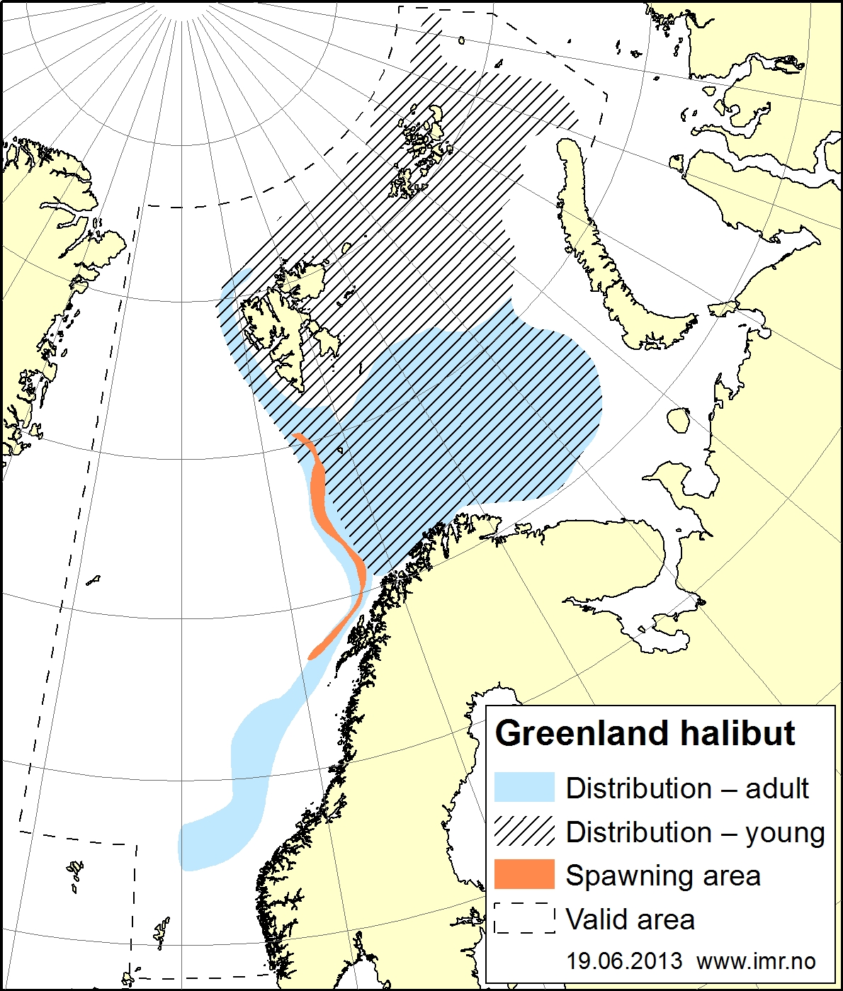
Surveys
No survey covers the whole distribution area
Data from three surveys are used to provide three indices
EcoJuv
EcoSouth
Norwegian slope
Russian autumn
Ecosystem survey
deviated into two
indices in the GHL
assessment

